Slide 1
Intelligent Waste Classification for a Sustainable Future
Batch members
VIGNESH K (211419105163)
SELVAKUMAR P (211419105132)
SASIDARAN S (211419105130)
VIGNESH V (211419105165)
Guide Name
Mr. N. KARTHIKEYAN
Assistant Professor

Slide 2
ABSTRACT
Garbage segregation is a challenge for cities worldwide.
Existing systems for garbage segregation can be expensive.
The proposed solution uses TensorFlow Lite, an Android app and an ESP8266 microcontroller.
The proposed system provides a cost-effective, automated approach for garbage sorting.

Slide 3
INTRODUCTION
The issue of waste management is a growing concern globally, with increasing amounts of waste generated each year.
The development of waste segregation systems has the potential to significantly improve waste management practices.
The proposed waste segregation system combines machine learning algorithms with hardware components to achieve accurate waste classification.

Slide 4
EXISTING SYSTEM
Lack of proper waste segregation leads to environmental pollution and health hazards.
Manual waste segregation is time consuming.
Automated waste segregation systems are available, but they not accessible to everyone.
These systems use complex models such as ResNet or VGG which require expensive hardware.

Slide 5
PROPOSED SYSTEM
Proposed system uses lightweight model called MobileNet.
It is faster and has lower hardware requirement compared to other CNN models.
The system is embedded in an Android application, eliminating the need for external image processing hardware.
To demonstrate the system’s capability, a prototype has been built that can sort objects into “Bio” or “NonBio”.

Slide 6
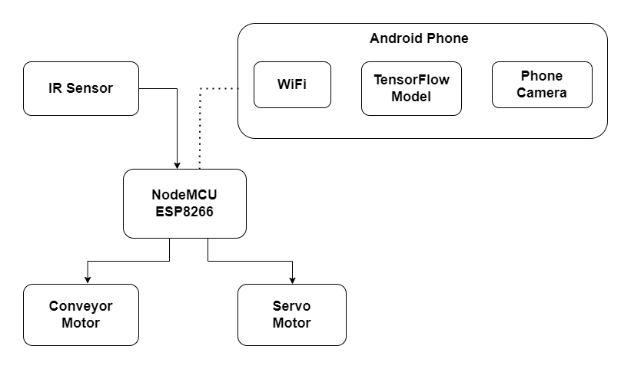
SYSTEM BLOCK DIAGRAM

Slide 7
CONSTRUCTION
The system consists of a conveyor belt, servo motor, IR sensor, NodeMCU board, and LEDs.
The conveyor belt is used to transport waste objects to the sorting area.
The servo motor is used to move the sorting arm to direct waste into the correct bin.
The IR sensor is used to detect when an object is in the sorting area.
The phone is placed on the top of the conveyor belt and it is connected in the same network.

Slide 8
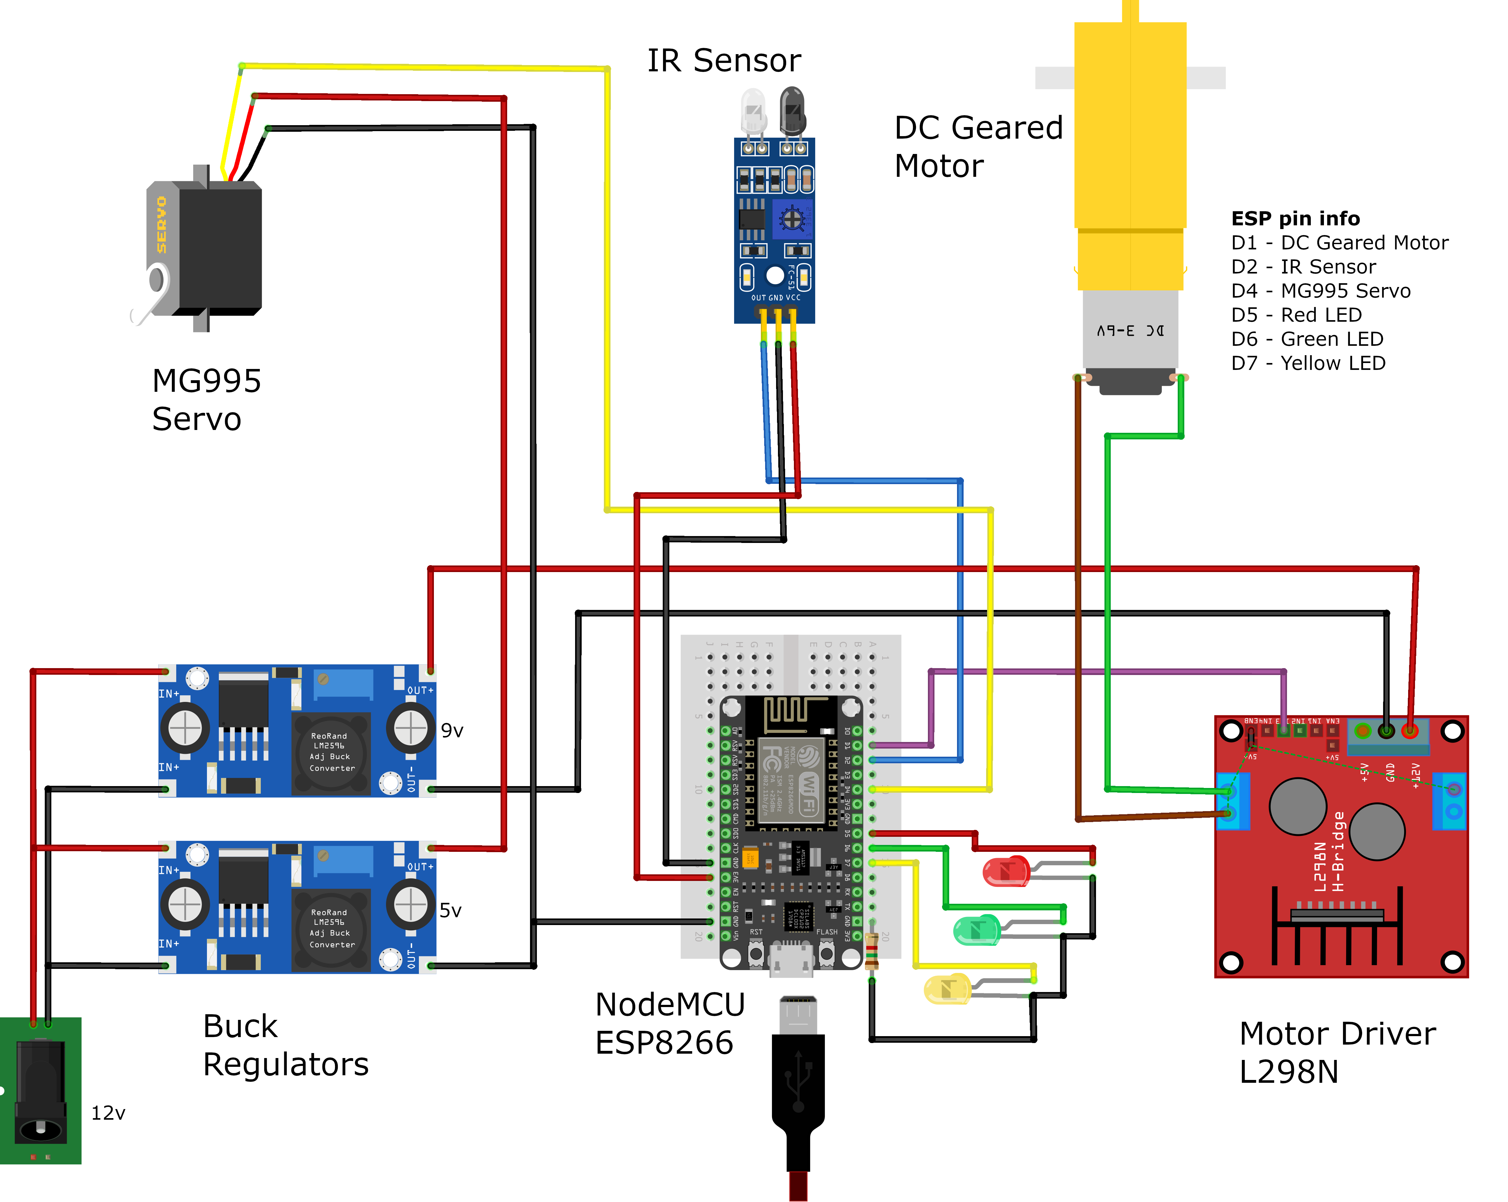
HARDWARE CIRCUIT DIAGRAM

Slide 9

WORKING
The user places the object on the conveyor belt, which moves forward until it reaches the IR sensor.
The IR sensor triggers the NodeMCU board, which turns off the conveyor motor and sends a HTTP request to the phone.
The phone sends a response indicating whether the object is "Bio" or "NonBio.“
Based on the response, the ESP8266 turns on the appropriate LED and tilts the plate to deposit the object in the corresponding bin.

Slide 10
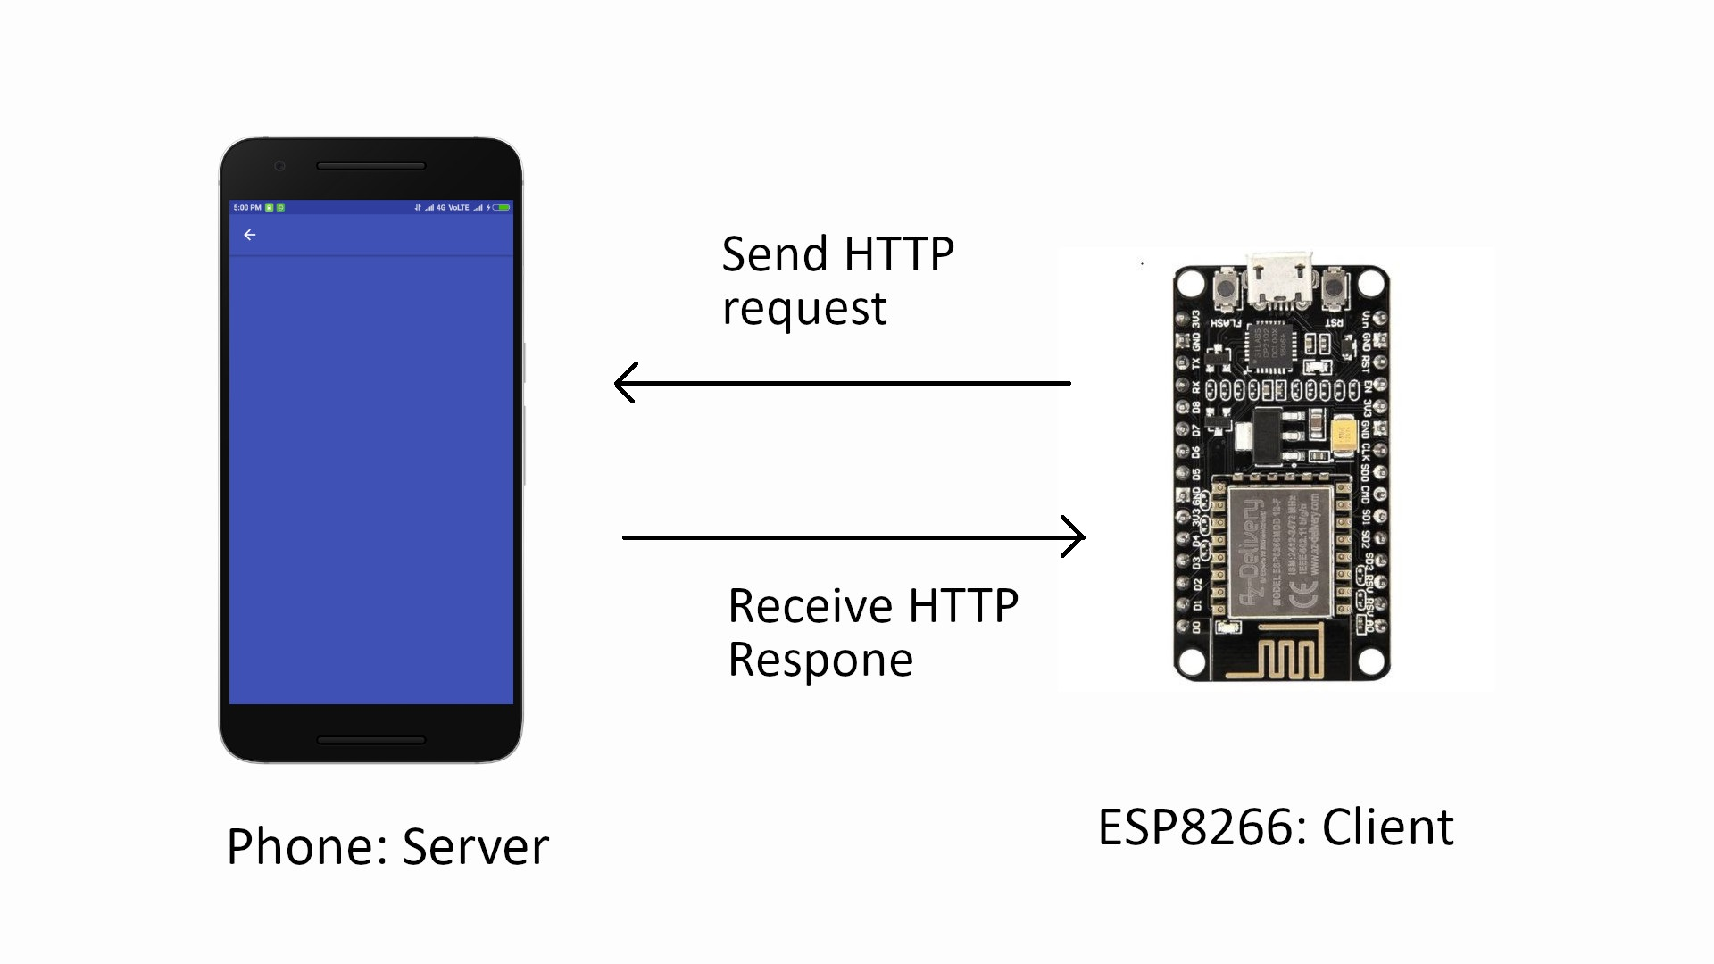
HTTP working

Slide 11
IMAGE PROCESSING
CNNs are deep neural networks used for image processing, extracting features and classifying them into predetermined classes.
Quantized MobileNet is a CNN optimized for mobile devices with high accuracy and speed.
Teachable Machine simplifies custom machine learning by allowing users to upload data and train without extensive programming knowledge.

Slide 12

Convolutional Neural Network working

Slide 13

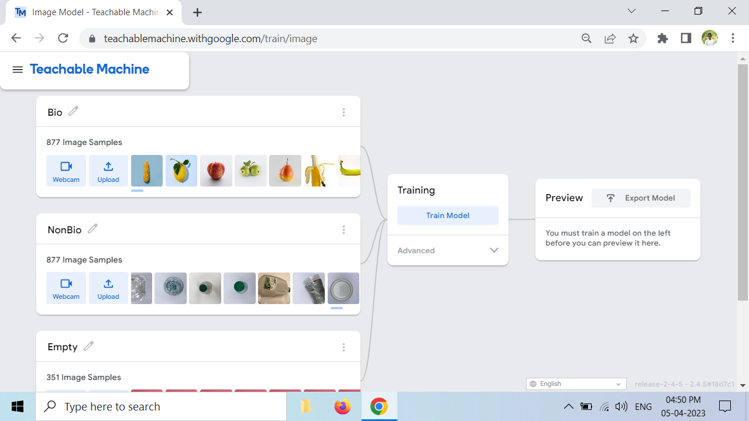
Android Studio
Teachable Machine

Slide 14
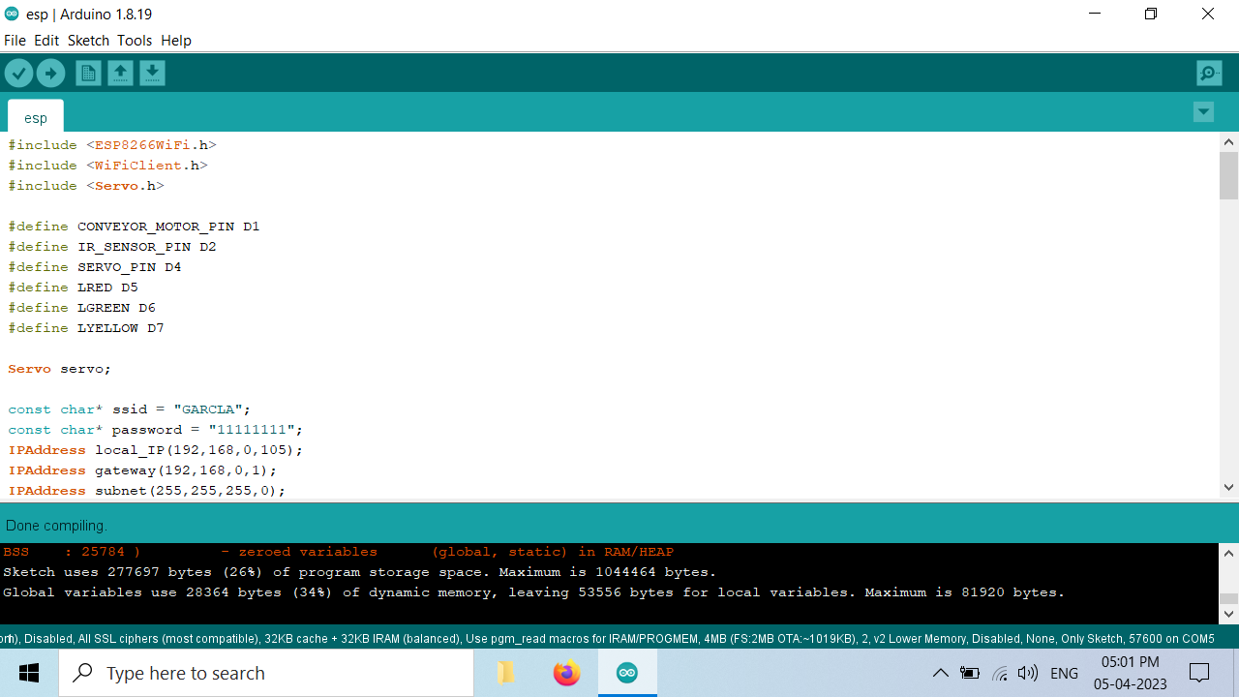
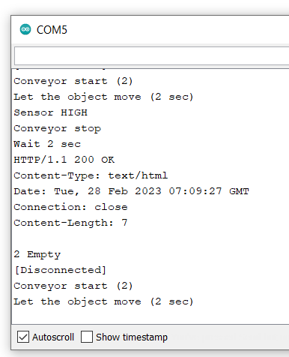
Arduino IDE and Output

Slide 15
ADVANTAGES AND DISADVANTAGES
Advantages
Disadvantages
Reduces labor, time and effort required for garbage sorting.
Hardware cost is significantly less compared to existing systems.
The software is easier to install, use and train new objects.
Can process only one garbage object at a time.
Garbage segregation consist of separation and sorting. Separation equipment is beyond the scope of this project.
Camera-based systems alone may lead to misclassification.

Slide 16
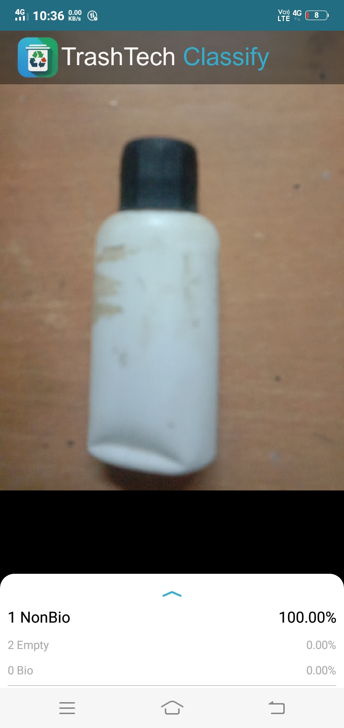
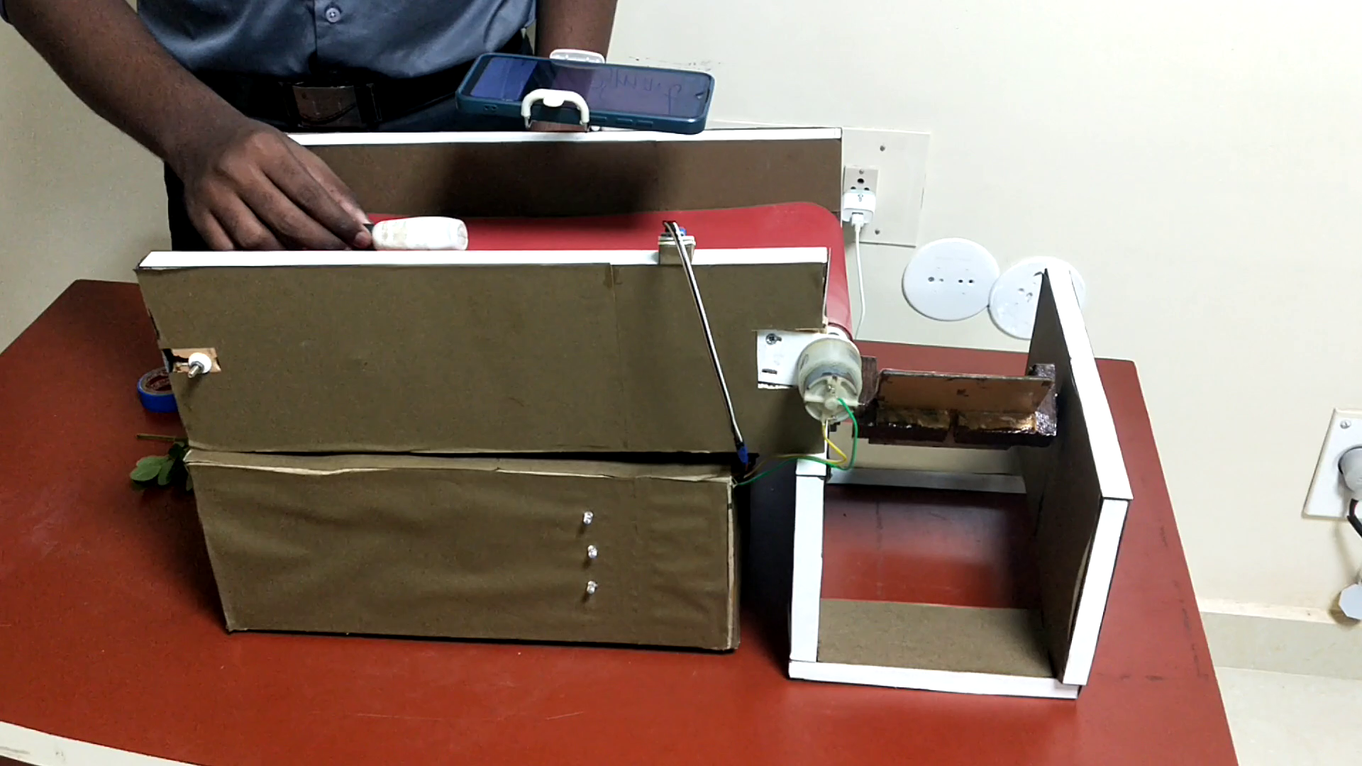
Entire System

Slide 17
REFERENCES
AMP Robotics (2022). Robotic Sorting. [online] AMP Robotics. Available at: https://www.amprobotics.com/robotic-system.
C. P, M.G.,Yadav,S.,Shanmugam, A.,V,H.and Suresh,N.(2021). Waste Classification and Segregation : Machine Learning and IOT Approach. [online] IEEE Xplore. doi:https://doi.org/10.1109/ICIEM51511.2021.944528
Google LLC (2023). Teachable Machine. [online] teachablemachine.withgoogle.com. Available at: https://teachablemachine.withgoogle.com/ [Accessed 4 Apr. 2023].
Kang, Z., Yang, J., Li, G. and Zhang, Z. (2020). An Automatic Garbage Classification System Based on Deep Learning. IEEE Access, 8, pp.140019–140029. doi:https://doi.org/10.1109/access.2020.3010496.
Patel, R. and Chaware, A. (2021). Quantizing MobileNet Models for Classification Problem. [online] IEEE Xplore. Available at: https://ieeexplore.ieee.org/document/9441115 [Accessed 4 Jan. 2023].

Slide 18
THANK YOU!

